Slide 1
Benefits beyond the paycheck – Exploring what matters most to employees
24 February 2022

Slide 2
Our Speakers
Jennifer Walker, Tate & Lyle (moderator)
Laurie Miller, Director of Employee Benefits, with M3 Insurance
Stacey Curry, Technical Specialist, IMEC
Emily Dienst, LCPC, CEAP, BHS Program Manager, Northwestern Medicine Kishwaukee Hospital

Slide 3
Our Agenda
Welcome and introductions
Setting the scene – What employees want in 2022
Refocusing your benefits to meet the cultural shift
Supporting employees through the pandemic and beyond through EAP programs
Local partners and resources who can help
Q&A

Slide 4
Setting the Scene: What employees want in 2022

Slide 5
Recruitment & Employee Appreciation
Staffing In A Tight Labor Market
24 February 2022

Slide 6
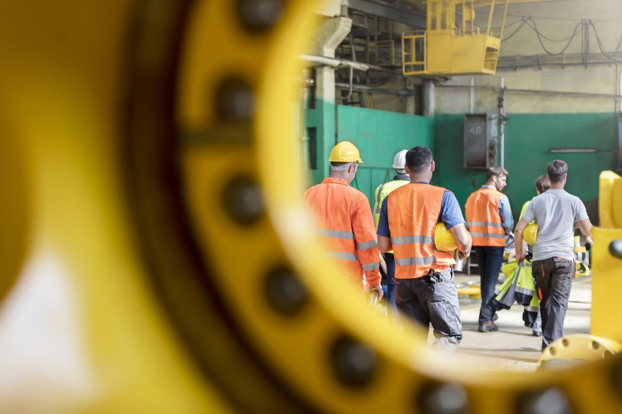
what employees want: 2022

Slide 7
Employees want: Safety
Covid-19 has made workplace safety a priority
Feature safety protocols to company website
Emphasize safety in job postings and job descriptions

Slide 8
employees want: Specific benefits
Emphasize total compensation package
Focus on what you can offer
Candidates increasingly want:
Higher wages
Paid sick time
Mental health support
Daycare assistance (flexibility)

Slide 9
employees want: A career
Candidates seek certainty in uncertain times
Emphasize growth opportunities
Candidates want to be proud of their work

Slide 10

Respond to market forces

Slide 11
Remote and telecommuting
The pandemic has changed office culture
Hybrid schedules could offer a balance for professional positions
Consider offering telecommuting or remote work

Slide 12
Competitive wages
Employees seek fair compensation
Offer the best possible starting wage
Candidates are aware of rising wages and inflation
Emphasize total compensation—pay and benefits

Slide 13

sourcing candidates

Slide 14
Connect using technology
Utilize virtual recruiting
Improve your social media presence
Broaden your search parameters

Slide 15
virtual recruitment
Increase your pool of applicants:
Easy online application process
Virtual job fairs
Virtual interviewing
Remote onboarding

Slide 16
Social Media
Candidates are on social media (all day)
Create an active presence on several platforms:
Post new opportunities
Interact with commenters
Post interactive content or host contests
Make it seem like a fun place to work

Slide 17
Broaden your search
Passive candidates: employed but willing to change
Past employees: contact excellent former employees
Be creative: consider hiring for attitude and training

Slide 18

retention and appreciation

Slide 19
Why employees change jobs
Greater flexibility (schedule and location)
Higher pay
Job security
Vacation time – work/life balance
Work culture
Note: Top reasons based on a 2021 Bankrate survey.

Slide 20
What motivates employees?
Employee motivation varies by individual or group
Common motivators:
Increased pay
Flexibility
Security
Culture
Vacation

Slide 21
Other motivators
Respect
Feeling included (heard and valued)
Reduced stress
Challenging work
Accomplishments

Slide 22

Employee appreciation

Slide 23
Appreciation tips and strategies
Conduct an anonymous survey to seek feedback
Improve areas of complaint (e.g., work processes)
Peer-to-peer recognition program
Catch them doing things right! – spot recognition

Slide 24
Appreciation tips and strategies
Manager recognition – people often quit managers
Recognize shorter milestones – 1, 2, 3-year
Some prefer private over public recognition (culture)
Reward performance with greater responsibility
Small gifts:
Gift cards
Company coffee tumblers or merchandise

Slide 25
Stay focused
Emphasize what you can offer
Listen to employees’ needs
Be creative
Learn employee motivators
Adapt recognition to individuals
Reassess strategies over time

Slide 26
Refocusing Your Benefits to Meet the Cultural Shift

Slide 27
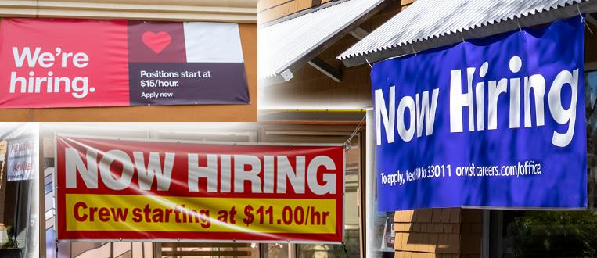
Now Hiring!

Slide 28
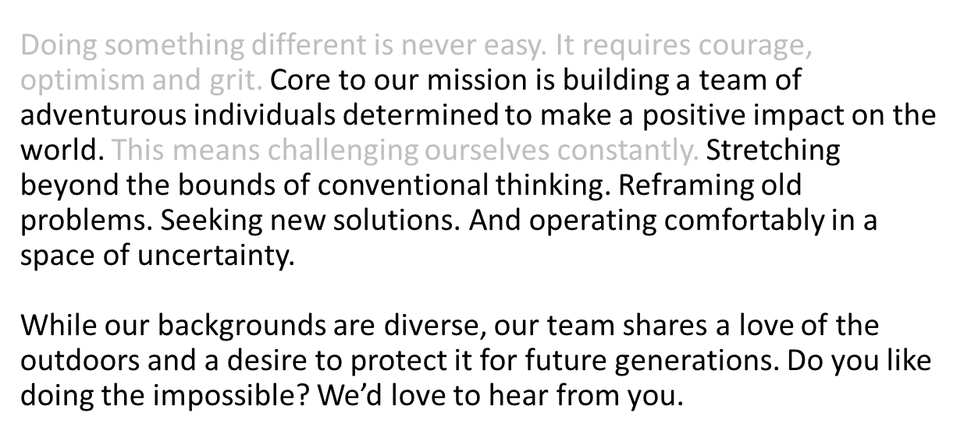

What’s Your Value Proposition

Slide 29
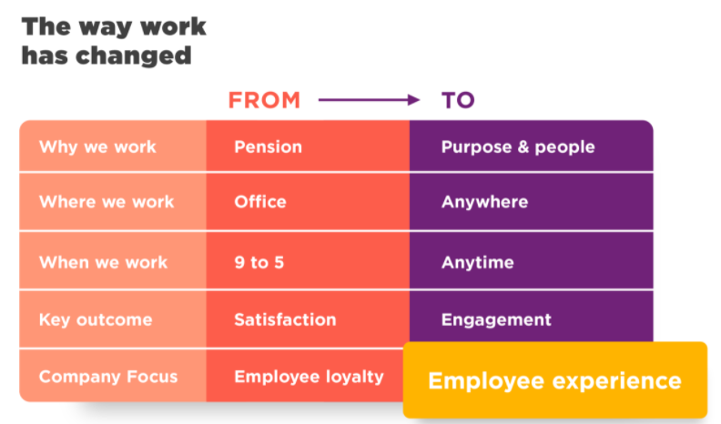
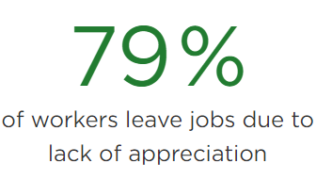
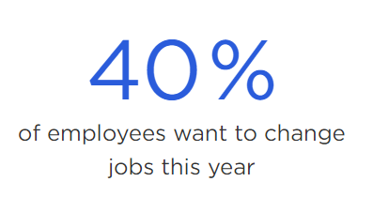
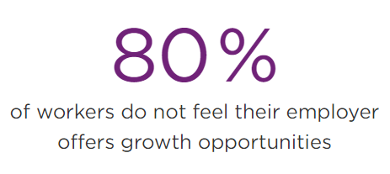

Slide 30
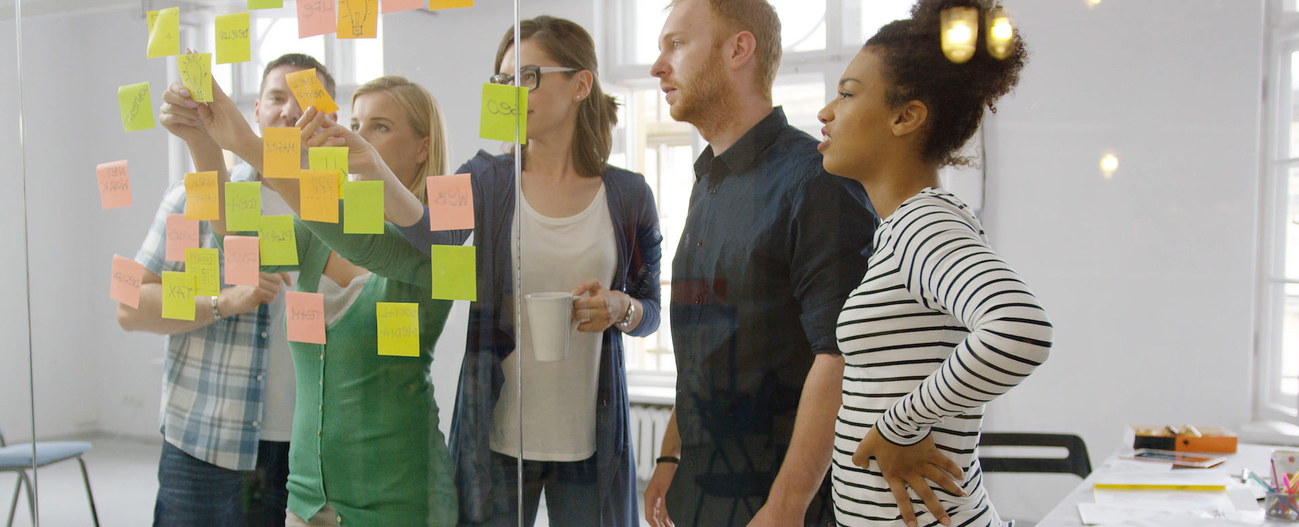
People-Centric A Shift In Work Culture
Look Within Culture is Everything
Value Proposition What Do you provide
Make it Social Collaboration and Working Together
Motivating Coach Not A Managing Boss
Continuous learning and development
Employee Experience journey
Create a Space Informational Interactions

Slide 31

Novel Approaches | Proven Approaches
Scavenger Hunt – Monday Trivia Swag - For No Special Reason Gym Passes or Discounts Start a Mastermind Group Book Discussions Host Monthly Mini-Celebrations Achievement Board Give Away Day Off Employee Artwork/Hobbies/Photo Display Referral Bonus Specific Company Holiday Create a Master of <Industry> Host On-Floor Demonstrations | Developmental Opportunities/Continuous Learning Culture Recognition and Acknowledgement – Value Driven Team Outings Volunteering as a Team Improvement Ideas/Distracter Jar Create an Employee-led Committee Kaizen Events/Discussion Groups Work Rotations/Cross Pollination Include Employees in Decision Making On-going Coaching Conversations vs. Annual Performance Reviews ASK

Slide 32

Honoring Diversity
Thank You/Kudos Notes translated into other languages
Signage
Interpreters
Flag and/or Cultural Displays
Multi-cultural Events
Closed Caption

Slide 33

Culture is Systemic People, Processes, Systems
Behave The Talk…
Extending Work Continuously
Fix Problems or Fractured Processes w/o Addressing Ownership and Accountability
Continuously Cutting Corners and Causing Extra Work
Following Through on Said Priorities
Continuous Changes w/o the Why’s
Meetings Lacking Purpose and Action
Bending Rules To Appease Favorites
Withholding Information / Controlling Chains of Communication
Negative Mindset / Gossip
Safe To Speak Up

Slide 34
Supporting Employees Through the Pandemic and Beyond

Slide 35
You, Me and the EAP
Concepts, goals and strategies
Presented by: Emily Dienst, LCPC, CEAP

Slide 36
You, Me and the EAP
Today’s presentation
EAP Models
Four Burners Theory
Creating Mastery
Building Resiliency

Slide 37
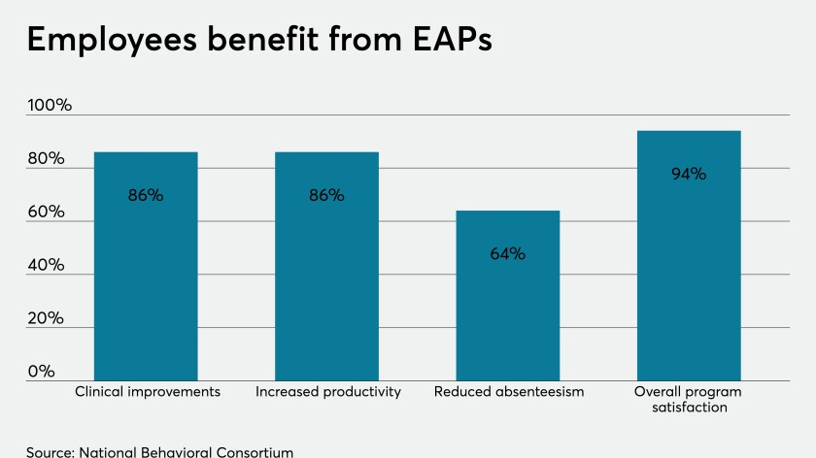
You, Me and the EAP
EAP Models
What the EAP can do for you/your employees
Traditional services offered

Slide 38
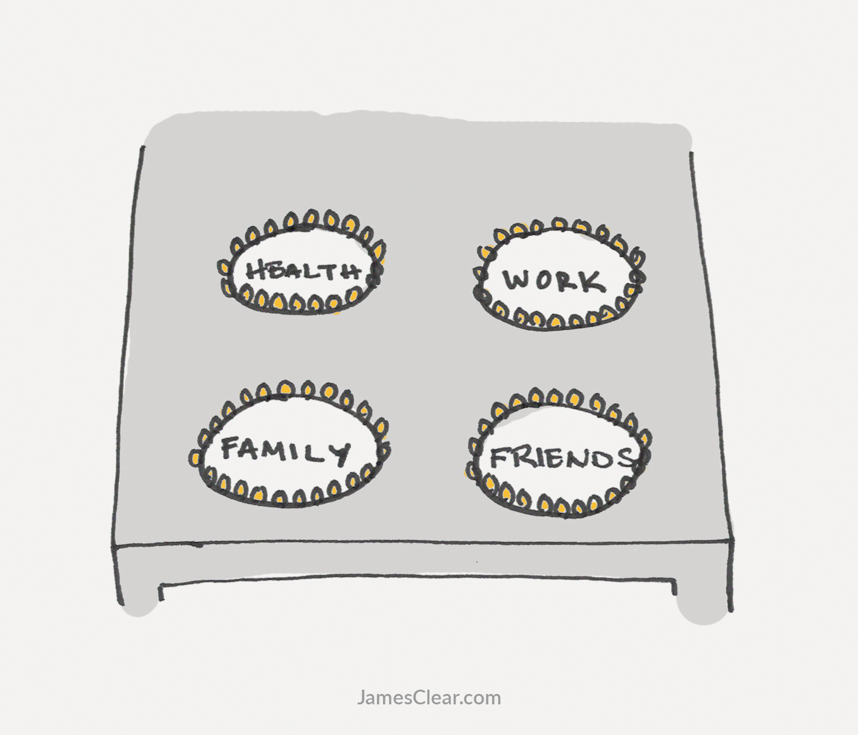
You, Me and the EAP
Four Burners Theory
Dividing resources
When to shift energy
Recognizing limitations
Notes:
Coined by David Sedaris, further explored in this image by James Clear.

Slide 39
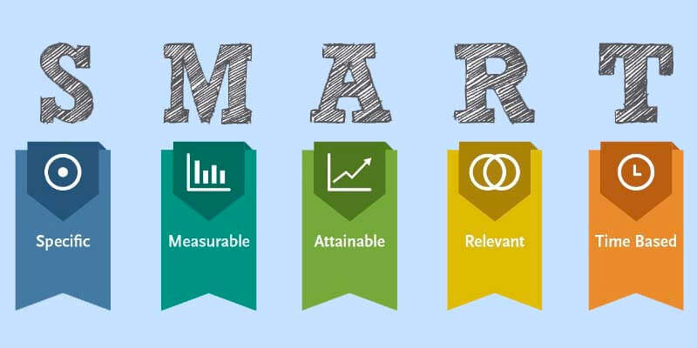
Stress During Uncertainty
Changing Habits
Sense of Mastery
Image courtesy of: https://www.toolshero.com/personal-development/smart-goals/

Slide 40

Stress During Uncertainty
Building Resiliency
Changing our wiring
Breathing
Mindfulness
Gratitude journaling
Movement
Fresh air
Connections

Slide 41
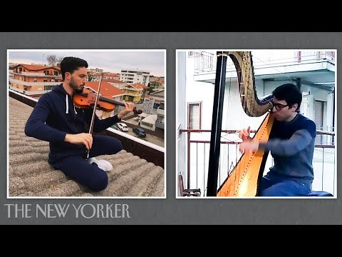
Stress During Uncertainty
Connections

Slide 42

Workplace Benefits- EAP
Where to next…
Take a step back
Examine your perspective
Clarify goals
Create tiny habits
Build connections
Find your village
Remind yourself, you’re in the driver’s seat

Slide 43
Q&A and DCEDC Resources

Slide 44

Thank you
DCEDC.ORG

